Slide 1
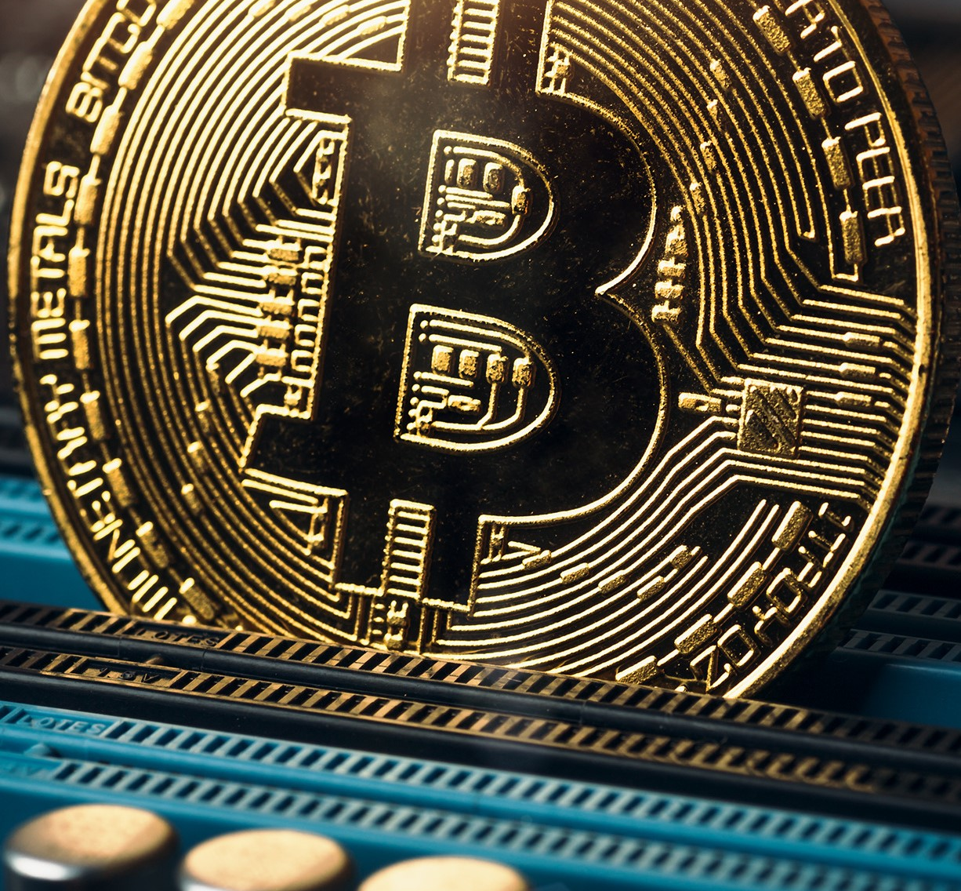
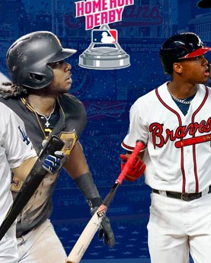
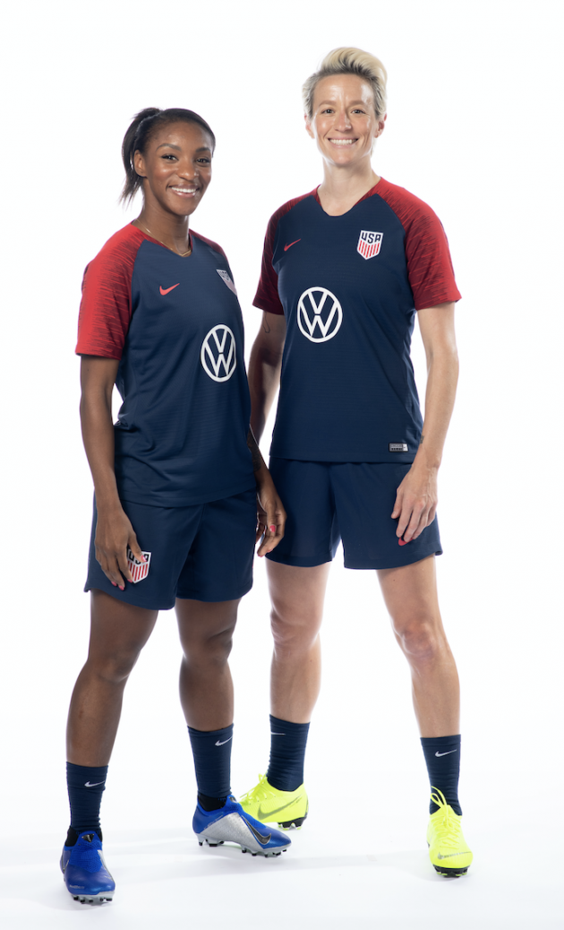
Emerging Categories, Industry Trends & Prospect Potential

Slide 2
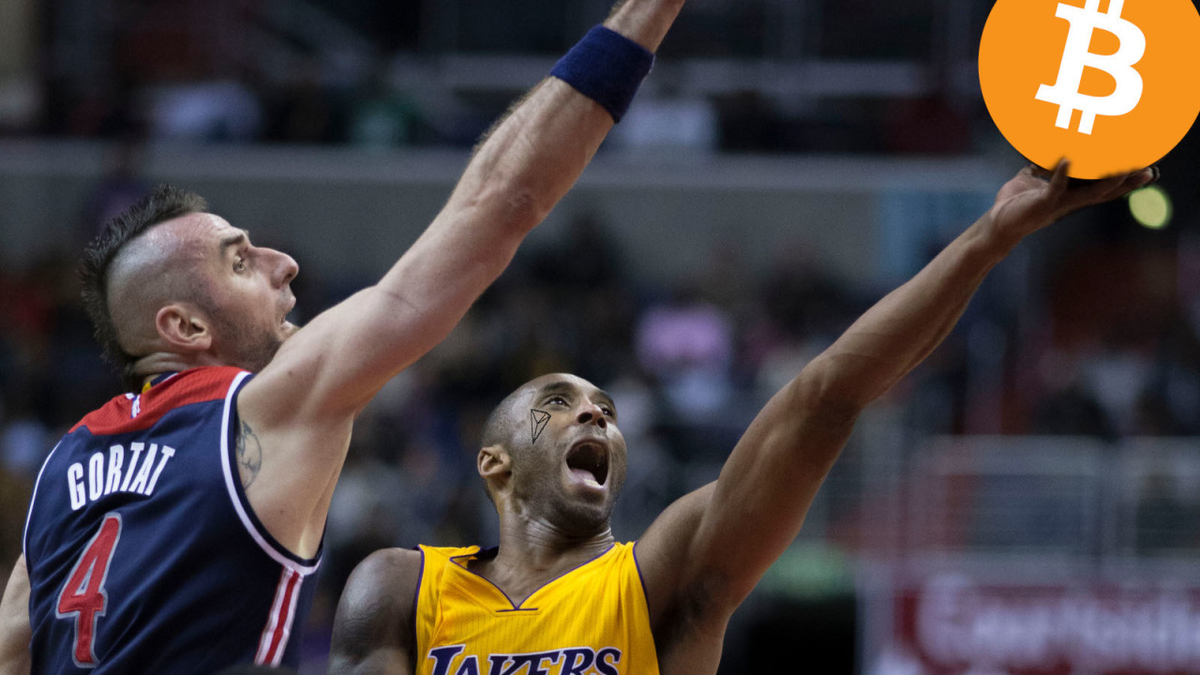
Emerging Category

Slide 3

An Emerging Category: Cryptocurrency
Cryptocurrency and blockchain companies have been making immense in roads into various sports leagues:
  Soccer
  UFC
  Basketball

Slide 4
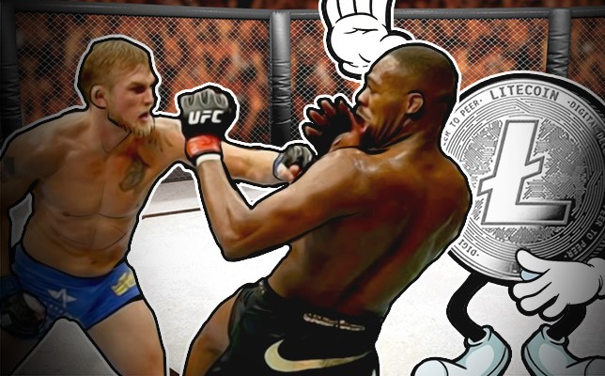
UFC x Litecoin
Designations and Goals
“Official Cryptocurrency Partner”
Drive Adoption of Cryptocurrency Across Sport Leagues
Drive Adoption of Cryptocurrency Through UFC Fan Base

Slide 5
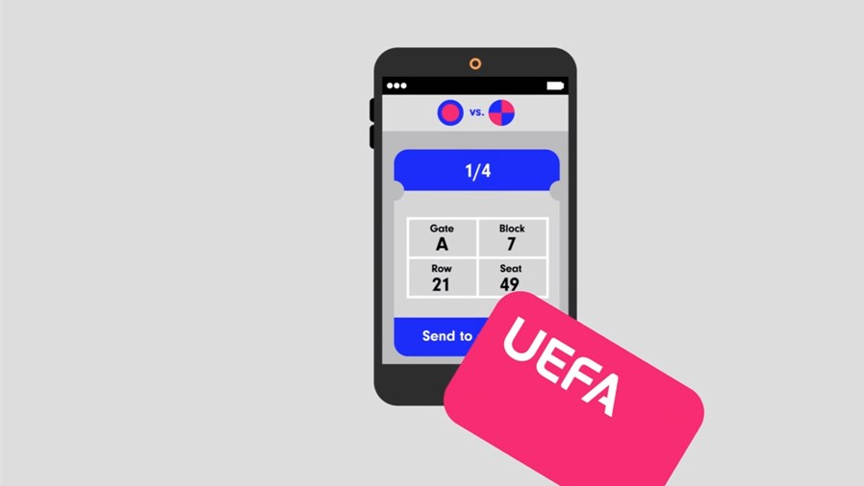
UEFA Ensures Ticket Security Through Blockchain
Value of Blockchain in Ticketing
Prevents forgery and duplication
Allows for all public ticket distribution to be carried through one provider
Provides streamlined stadium entry

Slide 6


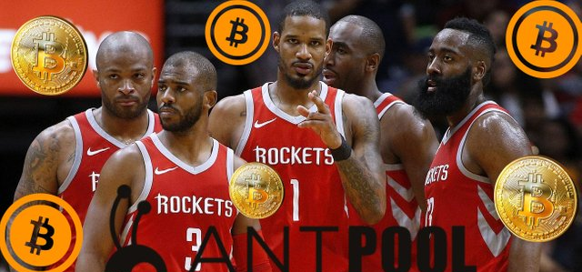
NBA Teams Dribble into Cryptocurrency

Slide 7
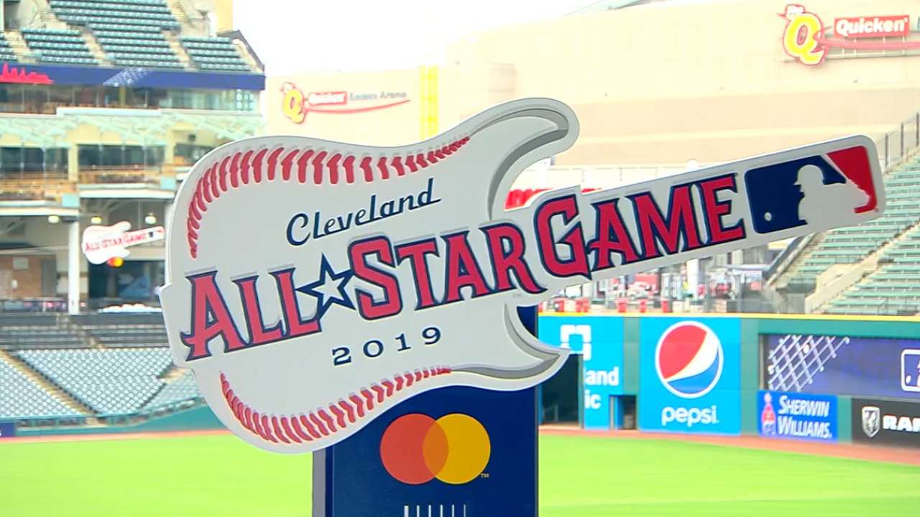
Industry Trends & Best Practices

Slide 8
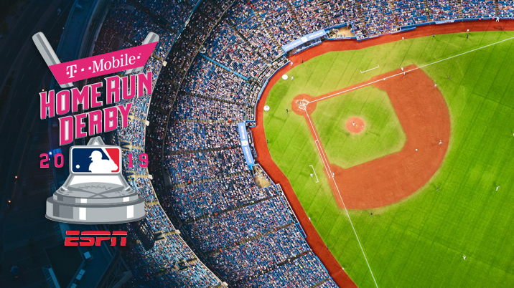
T-Mobile’s Wide Scope of Activation
T-Mobile Home Run Derby
T-Mobile Home Run Derby Bracket Challenge
2019 T-Mobile All-Star Hat Shop
Loads of Fun at Play Ball Park
Home Run Derby Participant Magenta Lounges
Donating $250k to Little League Baseball and Softball
Zipline Activation

Slide 9
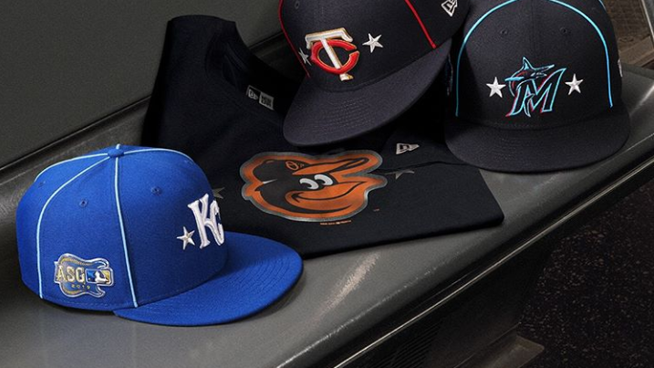
"Last year we had a human-sized claw machine, so we will be doing that again. We will be working with a small agency to do an activation with fans around the walk-up song idea. Overall, our goal is to break down the wall and let fans meet players, be part of what we are doing and walk away with some free swag.“
New Era Activation at MLB All Star

Slide 10
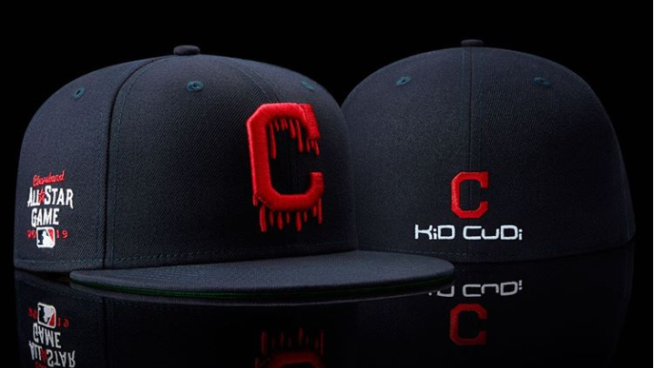
New Era x Kid Cudi x MLB All-Star

Slide 11
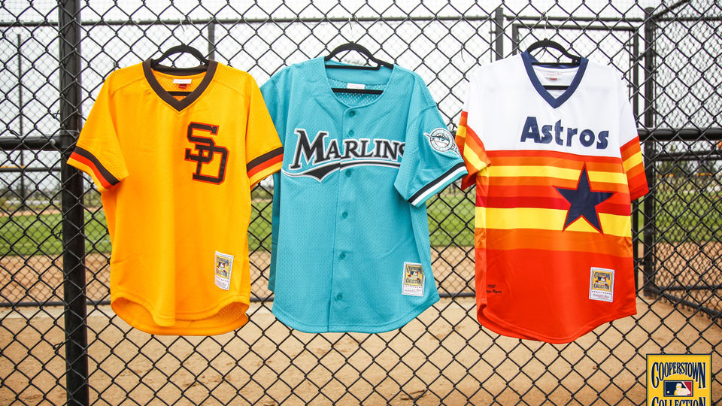
Mitchell & Ness Throwback Jersey Pop-Up
Products from all 30 teams
Featured Indians Gear
On-site customization
Tribute to MLB legend with a mural by local artist
Live music and DJ
Event will also feature Louisville Slugger, Stance and Fender

Slide 12
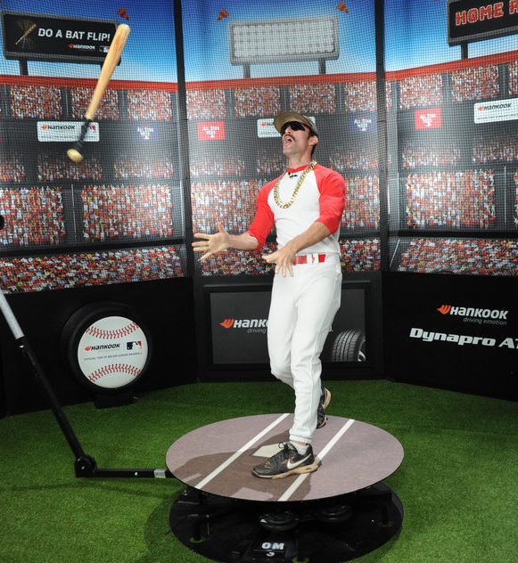
Hankook Tire Fan Engagement
Booth at PLAY BALL PARK where fans enjoyed:
  Special prizes with baseball-themed Hankook merchandise,
  Bat Flip simulator booth where fans could mimic their favorite players and be filmed by a 360 degree panoramic camera
Hankook hosted an honored military veteran at the MLB All-Star Game as part of its relationship with DAV

Slide 13
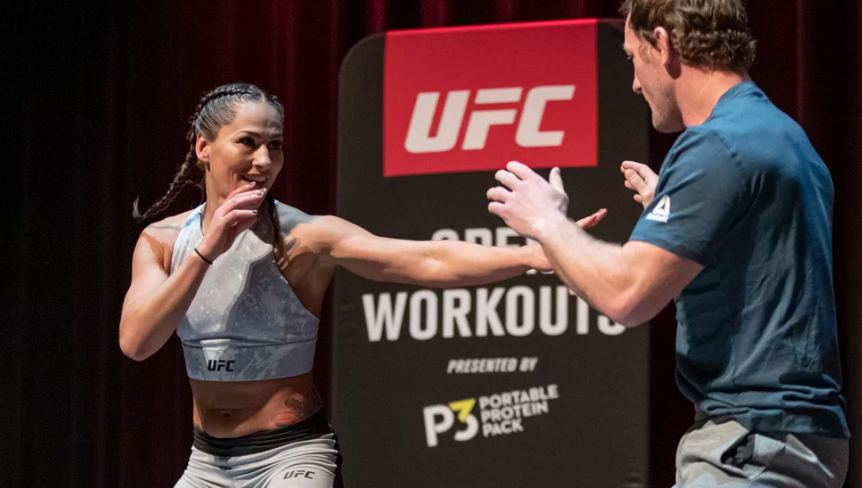
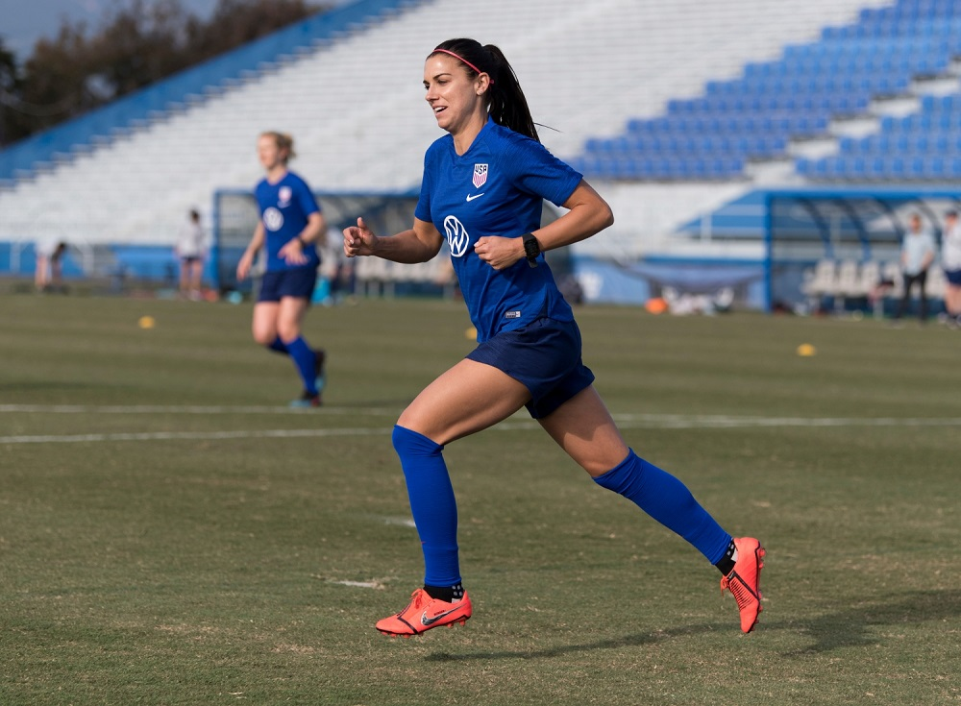
Prospect Spotlight
Volkswagen
P3 Oscar Mayer

Slide 14
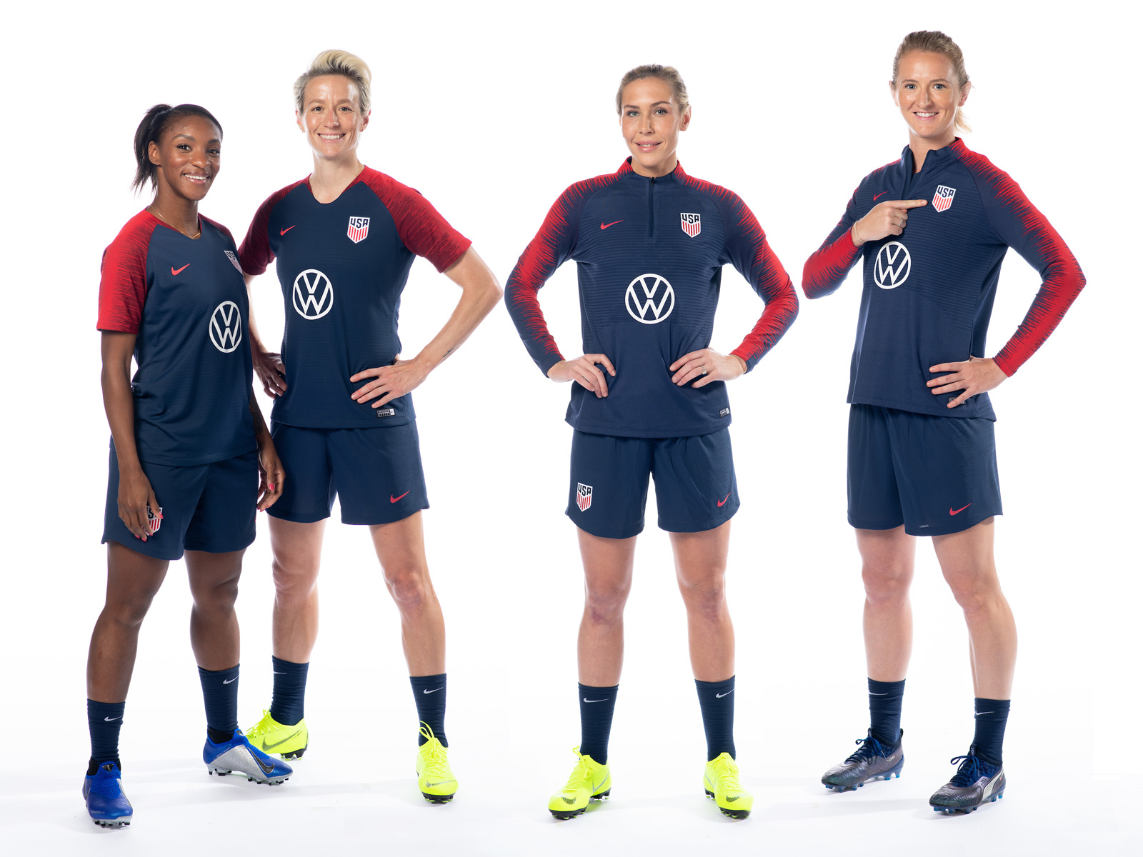
Volkswagen and US Soccer
Original content with current and former players
Jersey patch on all training uniforms
Money towards educating coaches and coaching certification
Title sponsor for the Tournament of Nations
Signed Alex Morgan as a brand ambassador
4 year, 8 figure deal

Slide 15
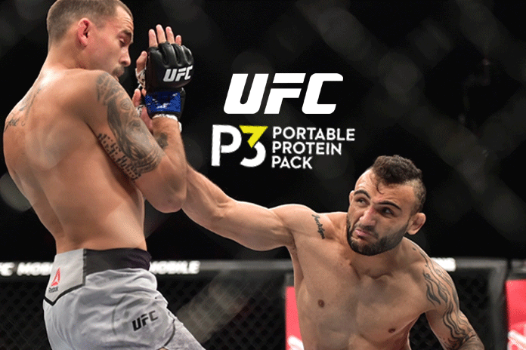
P3: “The Official Protein Snack of UFC”
P3 will have branded presence in the Octagon, integration of P3 into UFC telecasts, digital media campaigns and Fight Week integrations
P3 displays in select retail locations will feature UFC inspired palettes
P3 will produce an original content series at the UFC Performance Institute in Las Vegas to highlight importance of protein in athlete’s lives

